Slide 1
Power System Planning
Lecture No. 2
Muhammad Kamran, PhD
mkamran@uet.edu.pk

Slide 2

Lecture Contents
Terminologies and problems for power system planning
Diversity factor
Tariff
Load forecasting
Structure of power system

Slide 3
Diversity Factor
This is defined as the sum of individual maximum demands on the consumers divided by the maximum load on the system
This factor gives the diversification of the load and is used to decide the installation of sufficient generating and transmission plants
If all demands came at the same time i.e., unity diversity factor, the total installed capacity required would be much more
Luckily, the factor is much higher than unity, especially for domestic loads
High diversity factors may be provided if;

Slide 4
Giving incentives to farmers and/or some industries to use electricity in the night or light load period
Using day light saving as in many other countries
Staggering the office timings
Having different time zones in the country like USA, Australia, etc.
Having two-part tariff in which consumer has to pay an amount dependent on the maximum demand he makes, plus a charge of each unit energy consumed
Some times consumer is charged on the basis of KVA demand instead used frequently of kW to penalize loads of low power factor
Two other frequently used factors are;

Slide 5
plant capacity factor = Actual Energy Produced/Max possible energy which could be produced
=Average Demand/ Installed Capacity
Plant use factor = Actual Energy Produced/ Plant Capacity (KW) X Time (hrs) the plant has been in operation
Diversity and Demand factor is calculated in next slide

Slide 6
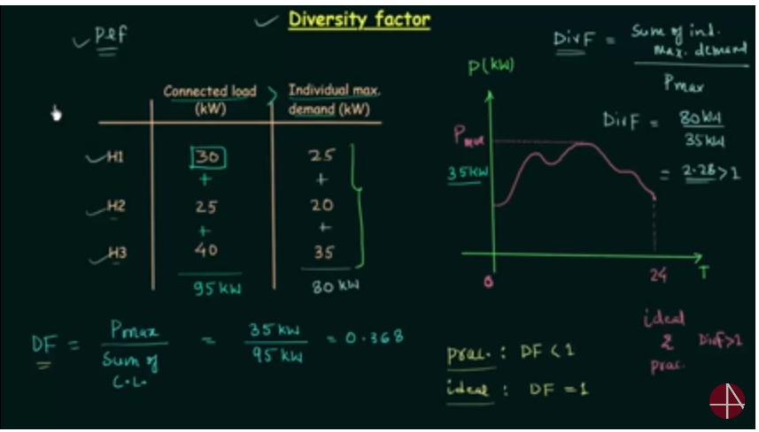

Slide 7
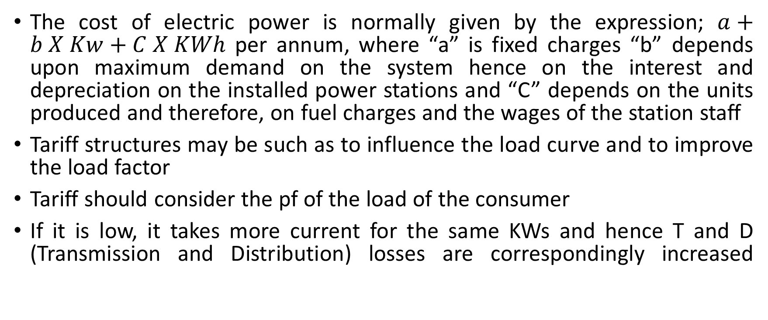
Tariffs
The cost of electric power is normally given by the expression; $a+b X Kw+C X KWh$ per annum, where “a” is fixed charges “b” depends upon maximum demand on the system hence on the interest and depreciation on the installed power stations and “C” depends on the units produced and therefore, on fuel charges and the wages of the station staff
Tariff structures may be such as to influence the load curve and to improve the load factor
Tariff should consider the pf of the load of the consumer
If it is low, it takes more current for the same KWs and hence T and D (Transmission and Distribution) losses are correspondingly increased

Slide 8
The power station has to install either pf improvement devices such as synchronous capacitors, SVC or voltage regulating equipment to maintain the voltages with in allowed limits and thus total cost increases
One of the following alternatives may be used to avoid low pf;
(i) to charge the consumers based on KVA rather than KW
(ii) a pf penalty clause may be imposed on the consumer
(iii) the consumer may be asked to use shunt capacitors for improving the power factor of his installation

Slide 9
Problems…..
Problem 1 …Tariff Calculation
Problem 2….Generation plant calculations

Slide 10
Load Forecasting
As power plant planning and construction require a gestation period of four to eight years or even longer for the present day power stations, energy and load demand forecasting plays a crucial role in power system studies
For long range forecasting, simple extrapolation techniques are adopted
Weather has more effect on residential forecasting as compare to industrial
Both power and energy forecasts are made
In short-term load forecasting, hour-by-hour predictions are made for the particular day under consideration

Slide 11
A minor forecast error on low side might indicate the use of inefficient, oil fired turbine generators
On the other hand, a high side forecast error would keep excessive generation in hot reserve
Accuracy of 1% is desirable
A temperature difference of 2 degree C can vary the total load by 1%
This indicates the importance of reliable weather forecast to a good load forecast

Slide 12
Definition of reserves
In a very simple words suppose a plant having 250 MW capacity in which initially 50 MW was reserved and the rest of 200 MW i.e. plant capacity from this the maximum demand is 150 MW.
Now the 150 MW is cold reserve, 200MW is hot reserve and (200-150) = 50 MW is spinning reserve initially 50 MW saved was firm power.

Slide 13
Regression methods are used to obtain short term load forecast which is very important and is required before solving unit commitment and economical load dispatch problems

Slide 14
Structure of Power systems
Generating stations, transmission lines and the distribution systems are the main components of an electric power system
Generating stations and distribution systems are connected through transmission lines which also connect one power system to another
Distribution system connects all the loads in a particular area to the transmission lines
The siting of hydro stations is determined by the natural water power sources.
The choice of site for coal fired thermal stations is more flexible.

Slide 15
The following two alternatives are possible;
1- power stations may be built close to coal mines (called pit head stations) and electric energy is evacuated over transmission lines to the load centres.
2- power stations may be built close to the load centres and coal is transported to them from the mines by rail road
In practice, however, power stations siting will depend upon many factors like technical, economical and environmental
As it is considerably cheaper to transport bulk electric energy over extra high voltage transmission lines than to transport equivalent quantities of coal over rail road

Slide 16
As nuclear stations are not constrained by the problems of fuel transport and air pollution, a greater flexibility exists in their siting, so that these stations are located close to load centres while avoiding high density pollution areas to reduce the risks, however remote, of radioactivity leakage
Electric power is generated at a voltage of 11 to 25 kV which then is stepped up to the transmission levels in the range of 66 to 765 kV
Voltages are expected to rise to 800 kV in the near future

Slide 17
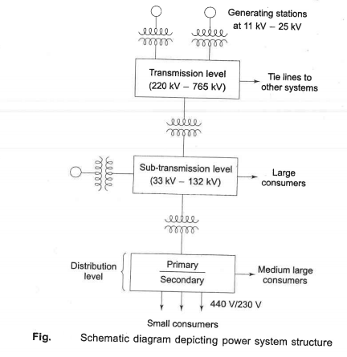

Slide 18
The first stepdown of voltage from transmission level is at the bulk power substation, where the reduction is to range of 33 to 132 KV depending on transmission line voltage
Next step down voltage is at distribution substation
11 KV/440V three phase and 230 volts single phase

Slide 19
Conventional Sources of Electric Energy
Thermal and hydro generations are the main conventional sources of Electric energy
The necessity to conserve fossil fuels has forced scientists and technologists across the world to search for unconventional sources of electric energy
Some of the sources being explored are solar, wind and tidal
The conventional and some of the unconventional sources and techniques of energy generation are briefly surveyed here with a stress on future trends

Slide 20
Thermal Power Stations
The heat released during the combustion of coal, oil or gases used in a boiler to raise steam
Heat generation is mostly coal based except in small sizes, because of limited indigenous production of oil
Therefore, coal-fired boilers for raising steam to be used in a turbine for electric generation
The chemical energy stored in coal is transformed into electric energy in thermal power plants
The heat released by the combustion of coal produces steam in a boiler at high pressure and temperature, which when passed through a steam turbine gives off some of its internal energy as mechanical energy

Slide 21
The axial-flow type of turbine is normally used with several cylinders on the same shaft
The steam turbine acts as a prime mover and drives the electric generator (alternator)
A simple schematic diagram of a coal fired thermal plant is shown in Fig. in next slide; pulvirizer is used for grind coal

Slide 22
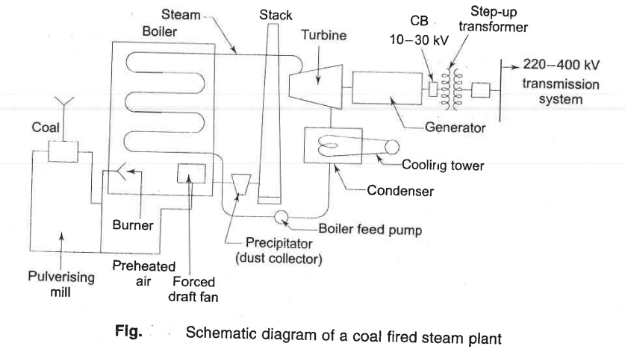

Slide 23
The efficiency of the overall conversion process is poor and its maximum value is about 40% because of the high heat losses in the combustion gases and the large quantity of heat rejected to the condenser which has to be given off in cooling towers or into a stream/lake in the case of direct condenser cooling
The steam power station operates on the Rankine cycle modified to include superheating, feed water heating, and steam reheating
Thermal efficiency can be increased by using steam at highest possible pressure and temperature

Slide 24
Rankine Cycle
The Rankine cycle is an idealized thermodynamic cycle of a heat engine that converts heat into mechanical work while undergoing phase change
The efficiency of the Rankine cycle is limited by the high heat of vaporization of the working fluid
This gives a theoretical maximum Carnot efficiency for the steam turbine alone of about 63.8% compared with an actual overall thermal efficiency of up to 42% for a modern coal-fired power station

Slide 25
With steam turbines of this size, additional increase in efficiency is obtained by reheating the steam after it has been partially expanded by an external heater
The reheated steam is then returned to turbine where it is expanded through final state
Air and thermal pollution is always present in a coal fired steam plant
The air polluting agents are emitted via exhaust gases and thermal pollution is due rejected heat transferred from condenser to cooling water
Cooling towers are used in situations where the stream/lake cannot withstand the thermal burden without excessive temperature rise
The problem of air pollution can be minimized through scrubbers and electro-static precipitators and by resorting to minimum emission

Slide 26
With increasing availability of natural gas prime movers based on gas turbines have been developed on the lines similar to those used in aircraft
Gas combustion generates high temperature and pressure so that the efficiency of gas turbine is comparable to that of steam turbine
Additional advantage is that the exhaust gas from the turbine still has sufficient heat contents, which is used to raise steam to run a conventional steam turbine coupled to a generator
This is called combined cycle gas turbine (CCGT) as shown in fig in next slide;

Slide 27
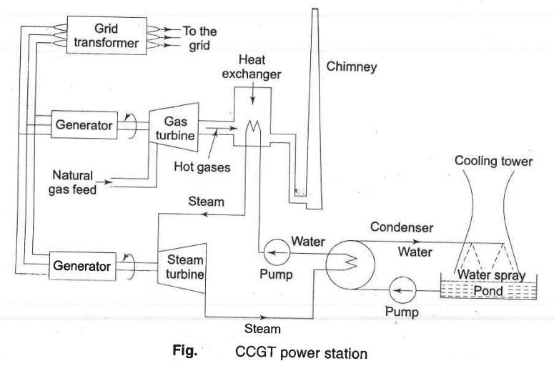

Slide 28
A heat exchanger is a device used to transfer heat between two or more fluids
The fluids may be separated by a solid wall to prevent mixing or they may be in direct contact
The CCGT plant has a fast start of 2-3 min for the gas turbine and about 20 min for the steam turbine
Local storage tanks of gas can be used in case of gas supply interruption
The unit can take up to 10% over load for short periods of time to take care of any emergency
CCGT unit produces 55% of CO2 by a coal/oil fired plant

Slide 29
Hydro electric power generation
The oldest and cheapest method of power generation is that of utilizing the potential energy of water
The energy is obtained almost free of running cost and is completely pollution free
But it involve high capital cost due to heavy civil engineering work
It involves long gestation period of about five to eight years as compared to four to six years for steam plants
Such plants are multipurpose such as river flood control, storage of irrigation and drinking water etc.

Slide 30
A simple block diagram of hydro plant is shown in next slide
The vertical difference between upper reservoir and tail race is called the head
Hydro plants are of different types such as run-of-river (use of water as it comes), pondage (medium head) type, and reservoir (high head) type.
The reservoir type plants are the ones which are employed for bulk power generation
Often, cascaded plants are also constructed, i.e., on the same water stream where the discharge of one plant becomes the in flow of a down stream plant

Slide 31
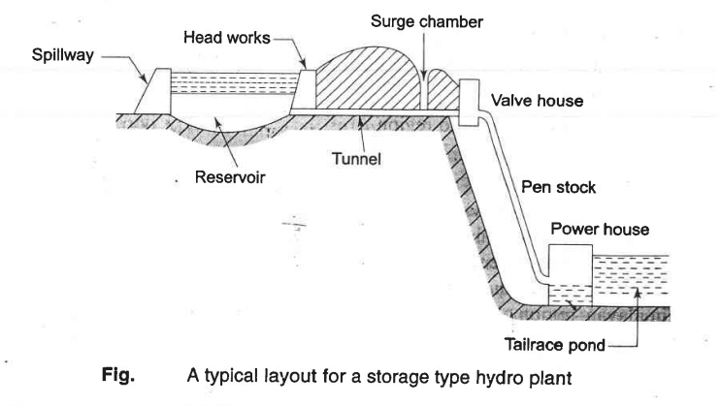

Slide 32
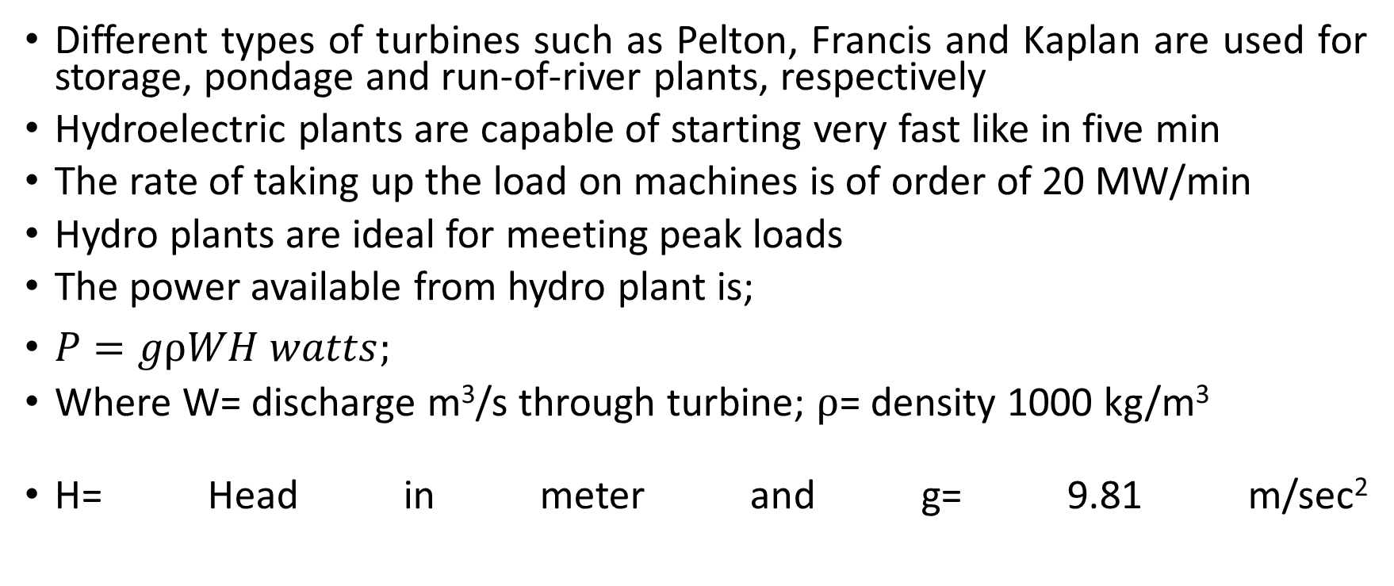
Different types of turbines such as Pelton, Francis and Kaplan are used for storage, pondage and run-of-river plants, respectively
Hydroelectric plants are capable of starting very fast like in five min
The rate of taking up the load on machines is of order of 20 MW/min
Hydro plants are ideal for meeting peak loads
The power available from hydro plant is;
$P=gρWH watts;$
Where W= discharge m³/s through turbine; $ρ$= density 1000 kg/m³
H= Head in meter and g= 9.81 m/sec²

Slide 33
Problems peculiar to hydro plant which inhibit expansion are: 1. Silting-It refers both to the increased concentration of suspended sediments, and to the increased accumulation (temporary or permanent) of fine sediments on bottoms where they are undesirable. 2. Seepage-Seepage Through Earthen Dams (Wet areas downstream from dams are not usually natural springs, but seepage through or under the dam. ... Seepage becomes a concern if it is carrying material with it, and should be controlled to prevent erosion of the embankment, or foundation, or damage to concrete structure) 3. Environmental damage to region 4. Displacement of human habitation from areas behind the dam which will fill up and become a lake

Slide 34
Problem -3
Hybrid Electricity generation and cost analysis

